Slide 1

AUTOMATIC FEATURE
GENERATION

Slide 2




POV OVERVIEW
Objective: To run fraud analytics model and see if an automated feature generation solution improves accuracy, run time and interpretability
Business Justification: Help and support/improve statistical modeling as well as discovering unknown data sets in an fast and efficient way.
Automated feature engineering solutions in the market:

Slide 3
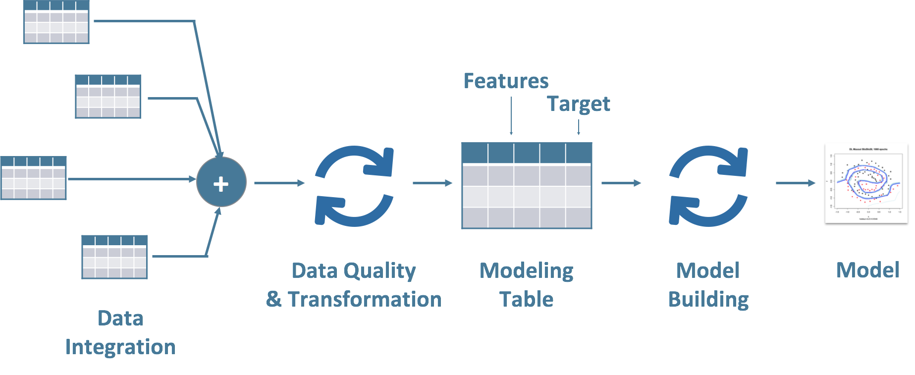
Machine Learning Work-Flow
Driverless AI

Slide 4


RESULTS
COST: Open source
License: $40K/Year
(Only single user access)
<50$(Infra Cost)
License:
Basic CART Model executed in R
Results from H20 Driverless AI
Results from Spark Beyond
Performance
Test AUC: 71.6%
Performance
Test AUC: 92.07%
Performance
Test AUC: 92.9%
Speed
Feature Engineering: NA
Feature Selection: NA
Model Parameter Tuning: NA
Model Training: 8 Mins
Speed
Feature Engineering: 14 mins
Feature Selection: 2 mins
Model Parameter Tuning: 1 min
Model Training: 2 Mins
Speed
Feature Engineering:
Feature Selection:
Model Parameter Tuning:
Model Training:
Interpretability
Features/Models: Good
Interpretability
Features/Models: Below Average
Interpretability
Features/Models: Average

Slide 5
Learnings & Next Steps
Learnings
H2o Driverless AI and Spark Beyond - provide a better accuracy by creating more features but interpretability of the features generated for business is still average.
H2o Driverless AI is a black box in terms of feature transformation levels and models built.
Feature Transformation Levels – IF a numeric to categorical encoding is done which band or levels help determine our prediction?
Models – We do not have information on algorithm or final output parameters in building model.
Feature Engineering not interpretable is these solutions as generic transformation would not work across verticals.
Cloud computing platforms provide perfect cost effective and scale-able platform to execute automated feature engineering solution
Increased Storage (Any dataset) and processors for faster execution.
Machine Learning Platforms to execute models.
Next Steps
Cloud platforms – Storage and ML Applications understanding. Any solution we build would be based on AWS/Azure/Google Cloud. (Proposed Architecture for this solution can be found in Slide #7)
Implement a feature engineering (FE) logic which is scalable in terms of interpretability
Categorize FE into generic and vertical based (More research to be done in this space)
Explore further solutions if available in this space.

Slide 6

Additional Details

Slide 7



PROPOSED ARCHITECTURE
Below architecture captures layers to be built over cloud platform for a driverless AI / Automatic feature generation and model building solution
Cloud Platform
(AWS/Google Cloud/Azure)
Raw Data
Feature
Engineering
Feature Selection
FE/FS
Logic
Machine Learning
Raw data to be stored in S3 Buckets

Slide 8







IMPORTANT VARIABLES
SPARK BEYOND
H2O DRIVERLESS AI
8th Digit of IBAN
Date of Last Schufa Feature
First Registration Date
Customer Wish Date
Provider To
Media Code
Delivery Service Provider
Risk-Index (Hardware)
Number of Schufa Features
Schufa Filter
2-digit code for Schufa feature
Product ID
Article Template ID
Place of Registration of Company(B2B etc..)
Request ID
Transaction ID
Application Score
CREDIT SCORE
SHOP ID
CAMPAIGN ID
ADDRESS
VERIFICATION
ORDER VALUE
AGE

Slide 9
H2o Features Interpretability
H2O Driverless AI generated around 2200 features and selected around 220 features for the model with highest accuracy. Some of them are shown below
Feature 1*
Transformation : Numeric to Categorical Target Encoding
Interpretation : A transformation formed by grouping Schufa Credit Score, Reference Product , Article Template ID, Shop ID , Media Code of Campaign, Request ID and Address Verification flag
For Business Use: No
CV_TE_I_AB_SCHUFA_SCOREBEREICH
Transformation : Cross Validation Target Encoding
Interpretation : Transformation on Schufa Credit Score
For Business Use : No
CV_TE_I_CS_TEXT_22_0
Transformation : Cross Validation Target Encoding
Interpretation : Transformation on Media Code
For Business Use : No
CV_TE_I_CS_UNSNUM_11_0
Transformation : Cross Validation Target Encoding
Interpretation : Transformation on Order Value
For Business Use : No
CV_TE_I_CS_M_TEXT_06__MO_2_0
Transformation : Cross Validation Target Encoding
Interpretation : Transformation on Article Template ID
For Business Use : No
CV_TE_I_AB_SCHUFA_FILTEXTE_0
Transformation : Cross Validation Target Encoding
Interpretation : Transformation on Schufa Filter
For Business Use : No
Feature 7*
Transformation : Numeric to Categorical Target Encoding
Interpretation : Transformation on 2-Digit Schufa Code, Schufa Credit Score, Product ID, Reference Product, Article Template, Shop ID, Place of Registration, Media Code, Address Verification and Application Score
For Business Use : No
*Refer Appendix Slide # 16 for Feature Definitions

Slide 10
Spark Beyond Features Interpretability
SPARK BEYOND generated around 170 features and features with highest marginal gain are shown below
i_ab_schufa_scorebereich = "“
Transformation : Subset
Interpretation : Schufa score unavailable
For Business Use : Yes
i_cs_m_text_03__mo_2 inRange (117,889 to 118,129)
Transformation : Subset in a range of numbers
Interpretation : Product ID between the 2 numbers
For Business Use : Yes
i_cs_text_23 != 0
Transformation : Subset
Interpretation : Paket Shop ID != 0
For Business Use : Yes
alter inRange (25.5 to 41.5)
Transformation : Subset in a range of numbers
Interpretation : Age in between 25.5 to 41.5
For Business Use : Yes
i_cs_text_20 = D2
Transformation : Creating a flag
Interpretation : If provider to value is ‘D2’
For Business Use : Yes
numberIn(i_cs_text_22) >= 32,031.5
Transformation : Returns the first number that was found in the text
Interpretation : If the number in
For Business Use : No
i_cs_unsnum_11 >= 559.76
Transformation : Creating a flag
Interpretation : If order value > $559
For Business Use : Yes

Slide 11
H2o Variable Transformations
H2O driverless AI uses the following transformations on the available columns and generates new features
Target encoding methods
Cross Validation Target Encoding
Cross Validation Categorical to Numeric Encoding
Categorical Target Encoding
Numeric to Categorical Target Encoding Transformer
Cluster Target Encoding Transformer
Cluster Distance Transformer
Weight of Evidence
Numeric To Categorical Weight of Evidence Transformer
Filter Transformer – Counts of values in Numeric columns
Frequent Transformer – Counts of categorical values
Bulk Interactions Transformer – Arithmetic Operations on the numerical columns
Truncated SVD Numeric Transformer – Matrix based dimensionality reduction Method
Dates
Dates Transformer – Month, Year, Weekday etc..
Date Polar Transformer – Month in Year
Text
Text Transformer - term frequency–inverse document frequency/counts to assign weights to the word in the whole column

Slide 12
Spark Beyond Transformations
Spark Beyond uses the following transformations on the available columns and generates new features
Numbers / Continuous Fields
Features by subset - Creating flags from continuous variables using basic comparison methods like equal, unequal, greater , between etc..
Algebraic Transformations – Transformations like floor, round, sigmoid etc. are applied to generate new features
Features by Interactions - Creates new variables by performing arithmetic operations combining multiple columns and create a new feature
Text
Features by subset – Uses conditions like contains, not contains etc. on substrings
Misc. – smallSubset, Normalized Histograms, prefixes etc.. are some unique functions applied on text based fields to generate new features.
Dates
Features by Subset – Year, Day, Month, Day of Week, Weekend/ Weekday etc..
Features by difference – Date Difference, Month Difference

Slide 13
Appendix

Slide 14
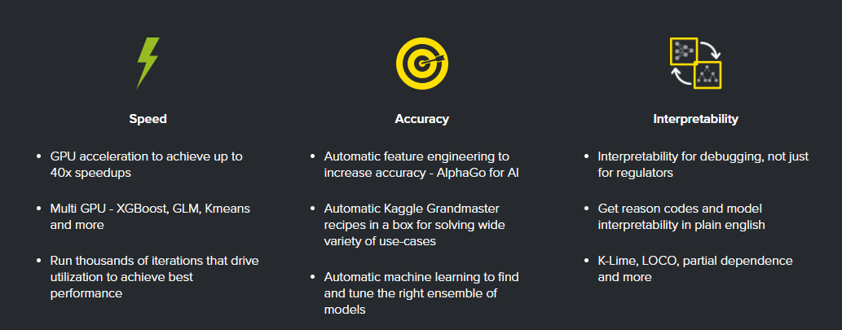





H2O DRIVERLESS AI
Driverless AI is the latest product from H2o.ai that automates entire data science process. The tool assists with preparing data, calibrating parameters and determining optimal algorithms that helps improve accuracy in model prediction.
Driverless AI Instances in cloud
POV Exercise
(1 month free trail license for driverless AI)

Slide 15
IMPORTANT VARIABLES
Based on features generated by H2O Driverless AI , the following variables are highly important
Important Variables | Description
ALTER | Age of customer
I_AB_SCHUFA_ANZ_MRK | Number of features (schufa (external credit agency) )
I_AB_SCHUFA_FILTEXTE | Schufa-filter
I_AB_SCHUFA_MRK_CODE | Two-digit code for schufa feature (external credit agency)): rank 1
I_AB_SCHUFA_SCOREBEREICH | Schufa-score aggregated into scorebands (A - P )(external credit score)
I_CS_M_TEXT_02__MO_1 | Orderdetails.Produktid:
I_CS_M_TEXT_03__MO_2 | Orderdetails.Referenzprodukt:
I_CS_M_TEXT_06__MO_2 | Orderdetails.Artikel_template ID
I_CS_TEXT_15 | Shop-id:
I_CS_TEXT_18 | Place of registration of companny (B2B, B2S, B2G only)
I_CS_TEXT_22 | Mediacode (code for certain campaigns)
I_CS_UNSNUM_11 | Sum of order value of basket case (hardware only)
I_IRP_TOP_CLIENTTRANSACTIONID | Request-id
ID_TRANSACTION | Transaction-id
O_CS_SIGNUM_08 | External information: address verification
O_OSC | Application score

Slide 16
GENERATED FEATURES
H2O DRIVERLESS AI
Index | Feature | Description | Relative Importance
1 | 201_NumCatTE_I_AB_SCHUFA_SCOREBEREICH_I_CS_M_TEXT_03__MO_2_I_CS_M_TEXT_06__MO_2_I_CS_TEXT_15_I_CS_TEXT_22_I_IRP_TOP_CLIENTTRANSACTIONID_O_CS_SIGNUM_08_0 | A transformation formed by grouping Schufa Credit Score, Reference Product , Article Template ID, Shop ID , Media Code of Campaign, Request ID and Address Verification flag is the variable with highest importance | 1.00
2 | 26_CV_TE_I_AB_SCHUFA_SCOREBEREICH_0 | Cross Validation Target Encoding of Schufa Credit Score | 0.20
3 | 73_CV_TE_I_CS_UNSNUM_11_0 | Cross Validation Target Encoding of Order Value in the Basket | 0.14
4 | 20_CV_TE_I_AB_SCHUFA_FILTEXTE_0 | Cross Validation Target Encoding of Schufa Filter | 0.13
5 | 37_CV_TE_I_CS_M_TEXT_06__MO_2_0 | Cross Validation Target Encoding of Article Template ID | 0.13
6 | 65_CV_TE_I_CS_TEXT_22_0 | Cross Validation Target Encoding of Media Code | 0.12
7 | 208_NumCatTE_I_AB_SCHUFA_MRK_CODE_I_AB_SCHUFA_SCOREBEREICH_I_CS_M_TEXT_02__MO_1_I_CS_M_TEXT_03__MO_2_I_CS_M_TEXT_06__MO_2_I_CS_TEXT_15_I_CS_TEXT_18_I_CS_TEXT_22_I_IRP_TOP_CLIENTTRANSACTIONID_O_CS_SIGNUM_08_O_OSC_0 | Numerical to Categorical Encoding of the following variables grouped – 2-Digit Schufa Code, Schufa Credit Score, Product ID, Reference Product, Article Template, Shop ID, Place of Registration, Media Code, Address Verification and Application Score | 0.11
8 | 207_NumCatTE_ALTER_ID_TRANSACTION_I_AB_SCHUFA_ANZ_MRK_I_AB_SCHUFA_SCOREBEREICH_I_CS_M_TEXT_02__MO_1_I_CS_TEXT_15_I_CS_UNSNUM_11_0 | Numerical to Categorical Encoding of the following variables grouped – Age, Transaction_ID, Number of Schufa Features, Schufa Credit Score, Product ID, Shop ID and Sum of Order Basket | 0.10
9 | 34_CV_TE_I_CS_M_TEXT_02__MO_1_0 | Cross Validation Target Encoding of Product ID | 0.07
10 | 60_CV_TE_I_CS_TEXT_15_0 | Cross Validation Target Encoding of Shop ID | 0.06

Slide 17
IMPORTANT VARIABLES
Based on features generated by SPARKBEYOND, the following variables are highly important
Variables | Description
AKZ_BLZ | 8th digit of IBAN (Banking group) with special missing for non-German banks
ALTER | Age of customer
I_AB_SCHUFA_DAT_LTZT_MRK | date of last Schufa feature
I_AB_SCHUFA_MRK_DATE2 | date of Schufa feature (external credit agency)): Rank 2
I_AB_SCHUFA_SCOREBEREICH | Schufa-Score aggregated into Scorebands (A - P )(external credit score)
I_CS_DATE_03 | FirstRegistrationDate: (Datum der Kundenanlage)
I_CS_DATE_04 | CustomerWishDate: (wird ab 24.03.2015 übergeben)
I_CS_M_TEXT_03__MO_2 | orderdetails.referenzProdukt:
I_CS_TEXT_15 | Shop-ID:
I_CS_TEXT_20 | ProviderTo: E1(E-Plus)/D2(VF)
I_CS_TEXT_22 | MediaCode (Code for certain campaigns)
I_CS_TEXT_23 | PaketshopID
I_CS_UNSNUM_09 | delivery service provider
I_CS_UNSNUM_11 | Sum of order value of basket case (Hardware only)
I_CS_UNSNUM_20 | Risk-Index Hardware (definition of Telco provider)
O_CS_SIGNUM_08 | External information: address verification

Slide 18
GENERATED FEATURES
SPARK BEYOND generated around 170 features of which these are top 10 features with highest marginal gain
Feature | Description
i_ab_schufa_scorebereich = "" | Input parameter of type String,
i_cs_text_23 != 0 | Input parameter of type Int
numberIn(i_cs_text_22) >= 32,031.5 | Returns the first number that was found in the text
i_cs_m_text_03__mo_2 inRange (117,889 to 118,129) | Reference Product ID in the range of 117889 to 118129
normalizedHistogram(i_cs_text_22).valueOf(9) >= 0.13 | a histogram of a list of values (no binning), where the frequencies sum up to 1.0. i.e. calculates a regular histogram and divides by the sum of all the counts
alter inRange (25.5 to 41.5) | Input parameter of type Int. Returns true if: from <= number <= to
Histogram(i_cs_text_22) does not contain (0, 1) | Input parameter of type String
i_cs_text_20 = D2 | Input parameter of type String
i_cs_text_15.tokens does not contain pu | Input parameter of type DomainName
i_cs_unsnum_11 >= 559.76 | Input parameter of type Double

